Slide 1
Project Presentation on
“Customer Retention”
Presented By
Pooja Jain(Int-34)

Slide 2
Agenda
Overview.
What is customer Retention?
Need of customer retention
Problem Statement
Problem Understanding
Exploratory data analysis(EDA)
Observations and Visualizations
Conclusion of study

Slide 3
Overview
Here will be looking upon:
How to analyze the dataset of Customer Retention
What are the criterion to achieve Customer Retention
Overall analysis on the problem.

Slide 4
What is Customer Retention
Customer retention is a metric that measures customer loyalty, or the ability for an organization to keep its customers over time.
In addition to identifying the number of loyal customers, customer retention can reflect or predict customer satisfaction, repurchase behavior, customer engagement and emotionally ties to a brand.

Slide 5
Need of Customer Retention
Less spending on customer acquisition : Acquiring a new customer can be up to five times more expensive than retaining an existing one.
Increased profits : An increase in client retention by 5% can enhance profits by over 25% .
Improved online reputation : Over 37% of customers will only post online reviews if they are “extremely satisfied”.
Positive Reviews : The longer customers stay with a company, the more business, positive reviews, and they bring word of mouth advertising.

Slide 6
Why Customer Retention
A data-driven customer retention strategy can reap rewards in a big way, if you do it right. In fact, it’s proven to drive profit.
A McKinsey report states that “executive teams that make extensive use of customer data analytics across all business decisions see a 126% profit improvement over companies that don’t” (McKinsey, 2014).

Slide 7
Problem Statement
Customer satisfaction has emerged as one of the most important factors that guarantee the success of online store; it has been posited as a key stimulant of purchase, repurchase intentions and customer loyalty. A comprehensive review of the literature, theories and models have been carried out to propose the models for customer activation and customer retention. Five major factors that contributed to the success of an e-commerce store have been identified as: service quality, system quality, information quality, trust and net benefit. The research furthermore investigated the factors that influence the online customers repeat purchase intention. The combination of both utilitarian value and hedonistic values are needed to affect the repeat purchase intention (loyalty) positively.

Slide 8
Problem Understanding
Customer retention means the process of maintaining or keeping customers once you have acquired them.
It’s all the activities that a company must do in order to keep their customers around.
The goal is to build a long-lasting relationship between the brand and consumers.
Once a customer becomes loyal to your brand, not only he will buy more from you than a normal customer but he’ll spread good words about your business, increase your reputation.
I have used all my analytical skills to solve the problem of customer retention.

Slide 9
Exploratory data analysis(EDA)
I have imported the dataset which was in excel format.
As the column names were very descriptive and they look hard to handle with unnecessary spacing so I have changed my column names in new excel file and used that for further analysis.
Then I did all the statistical analysis like checking shape, nunique, value counts, info etc.
I have checked for null values but luckily there was no null values in the dataset provided.
I have used Pie-charts, Crosstabs, Countplots ,Line graph for analysis.

Slide 10
EDA
1.General feature describing Population and online shopping
Here we have done personal detail analysis of customers and trend of shopping.
2.Feature describing Devices and technology used
Here we have done Device analysis of customers and Operating system , browser and Channel used for shopping

Slide 11
EDA
3. Feature describing Site Exploration, Buying Decision and Payments
Here we analyze time spent before shopping, cart behavior ,payment methods etc. of customers.
4. Features describing Website and performance, online shopping convenience and satisfaction
Here we study the overall shopping experience with site.

Slide 12
EDA
5. Features Describing thoughts about various stores available and recommendations
Here we study the views about different shopping sites and behavior of site at festival and offer time. Also get insight about the recommendations.

Slide 13
Observations
Female are doing more shopping compared to men and females with age group 21-30 and men of age group 31-40 are shopping more than other age groups.
I found more customers in Great Noida and they belong to above 4 years of online shopping experience.
In all the frequencies of online purchase in past 1 year the usage of mobile internet for internet access is having high count.
All the smartphone users has Maximum count for 5.5 inches screen size and for all other devices screen size is not specified i.e., others option.

Slide 14
Observations
All the window users and Maximum Android users uses Google Chrome as there browser and IOS/Mac users use Safari as there browser.
Maximum customers uses Search Engine to visit the online store for first time and after first visit also again they login using search engines so search engines are the good mode to get hike in number of customers.
Maximum customers uses the e-retail shop for more than 15 minutes to make purchase decision and Maximum customers uses credit/debit card as payment option.
Maximum customers sometimes abandon and the major reason for abandons is to get better alternative offer.

Slide 15
Observations
Maximum customers agrees to have the content on the web page to be easy to read and understand and they also agrees to get information on similar product to the one highlighted is important for product comparison.
Maximum people agrees to have all relevant information on listed products and agrees with complete information on listed seller and product being offered is important for purchase decision.
Maximum customers agrees to get easy navigation in website and they wants to have loading and processing speed.
Maximum customers wants user friendly interface of the website and convenient payment methods.

Slide 16
Observations
Maximum customers agrees to get Trust that the online retail store will fulfil its part of the transaction at the stipulated time and expects Empathy towards the customers.
Maximum customers wants to have the guaranteed privacy of the customer and they wish to have Responsiveness, availability of several communication channels.
Maximum customers agrees that Online shopping gives monetary benefit and discounts and they also agrees that Enjoyment is derived from shopping online.
Maximum customers agrees that shopping online is convenient and flexible and they also agrees that return and replacement policy of the seller is important for purchase decision.

Slide 17
Observations
Maximum customers agrees with Gaining access to loyalty programs is a benefit of shopping online and they also agrees that displaying quality information on the website improves satisfaction of customers.
Maximum customers agrees that user derive satisfaction while shopping on a good quality website or application and they also agrees that net benefit derived from shopping online can lead to users satisfaction.
Maximum customers agrees to have user satisfaction cannot exist without trust and they also agrees that offering a wide variety of listed product in several category.
Maximum customers agrees to have provision of complete and relevant product information and they also agrees to have monetary savings.

Slide 18
Observations
Maximum customers agrees for having the convenience of patronizing the online retailer and they also agrees that shopping on website gives us the sense of adventure.
Maximum customers agrees they feel gratification shopping on there favourite e-tailer and they also agrees that shopping on your preferred e-tailer enhances there social status.
Maximum customers agrees shopping on the websites helps to fulfil certain roles and they also agrees that they need value for money spent.

Slide 19
Observations
Maximum customers choose that all the available online shopping platforms are easy to use and they also shop from more than one online shopping websites.
Maximum customers choose Amazon and Flipkart as the best visual appealing web-page layout and platform which gives wide variety of product on offer.
Most of the customers chooses Amazon and Flipkart as the best platform that gives complete and relevant description of products and also they choose Snapdeal as the fast loading website.
Maximum customers says that Reliability of the website or application and quickness to complete purchase is good with Amazon.

Slide 20
Observations
Maximum customers chooses Amazon and Flipkart as having best payment option available and also they are giving fastest delivery also.
Maximum customers chooses Amazon for giving best customers information privacy and also for giving best financial information security.
Amazon is the best online shopping mart which gives perceived trustworthiness and it has the presence of online assistance through multi-channel.
As Amazon is the maximum used online shopping platform it is also having drawback of taking longer time to login and taking longer time in displaying graphics and photos.

Slide 21
Observations
Maximum customers says that the drawback of having late declaration of price is with Myntra and longer page loading time is with Flipkart.
Snapdeal has a drawback of having limited payment modes and also it has a complaint of late delivery.
Maximum customers says that Amazon is the platform with good website/application design and also amazon has a drawback of disruption of pages when moving from one page to another.
Maximum customers says that the efficiency of website is good with Amazon and also amazon is recommended by most of the customers.

Slide 22
Visualizations
All the charts and graphs for the observations

Slide 23
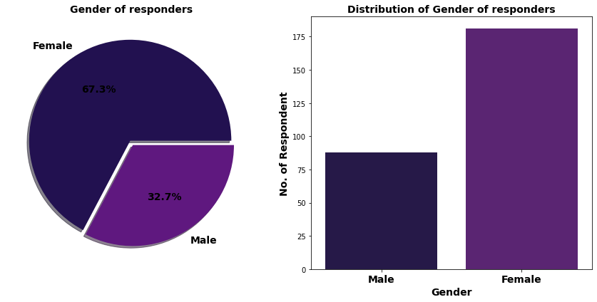

Slide 24
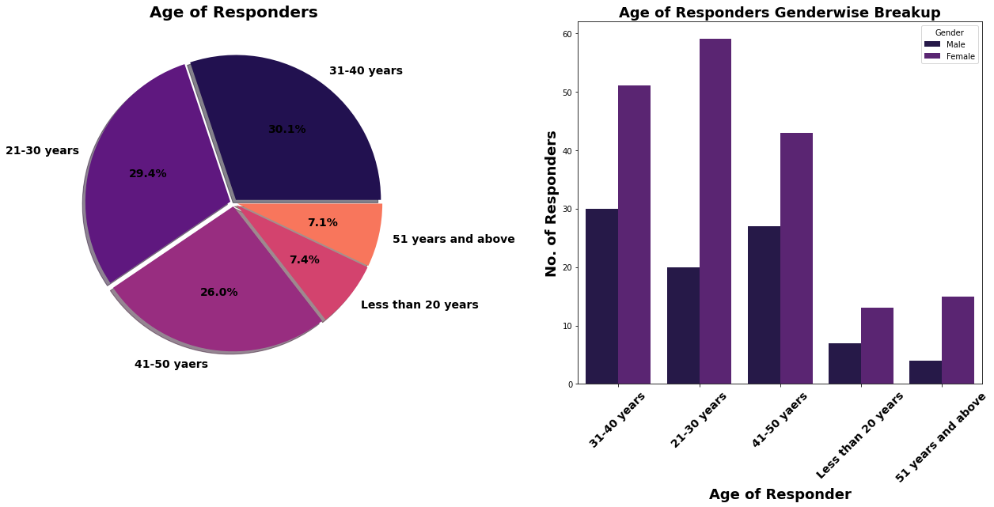

Slide 25
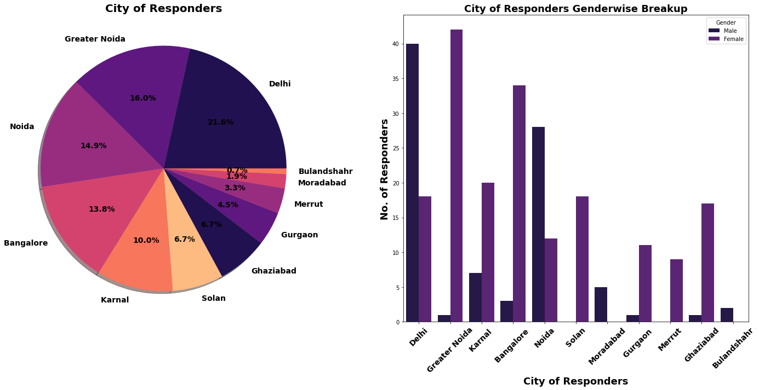

Slide 26
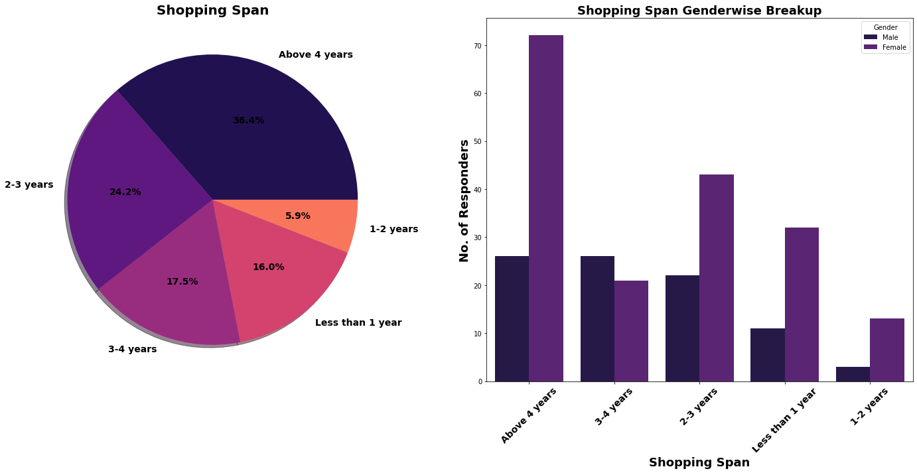

Slide 27
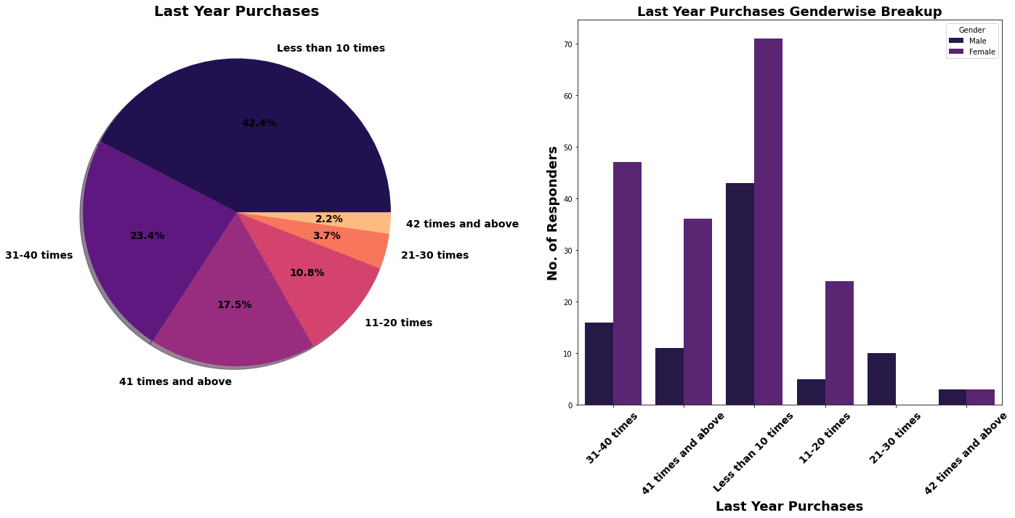

Slide 28
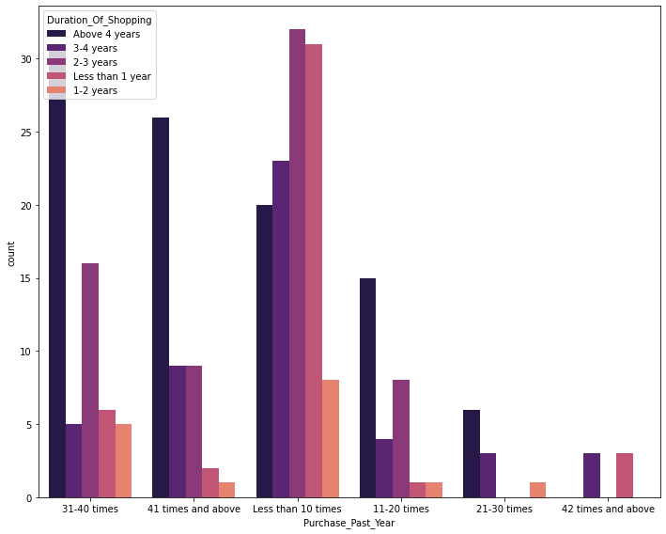

Slide 29
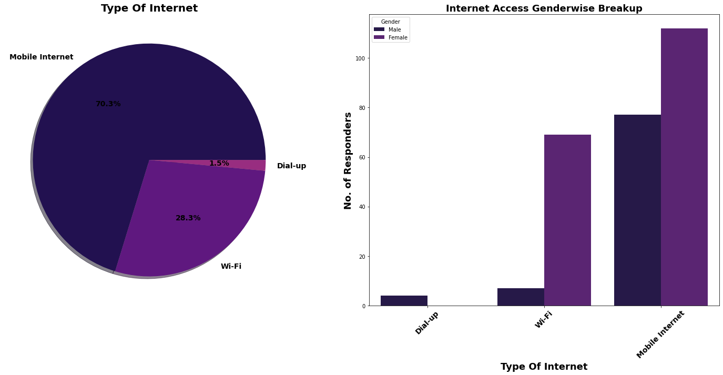

Slide 30
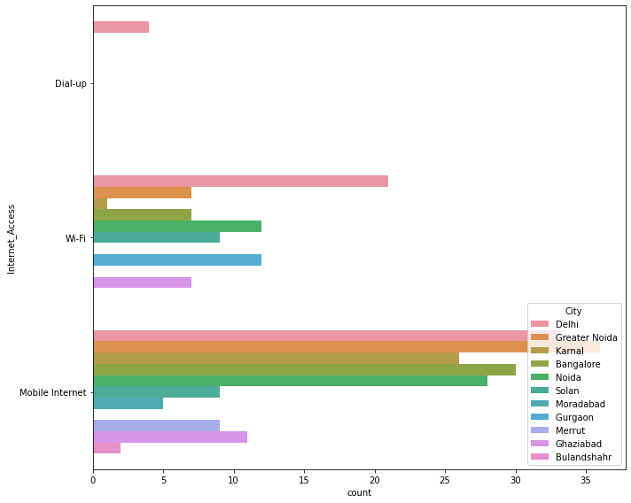

Slide 31
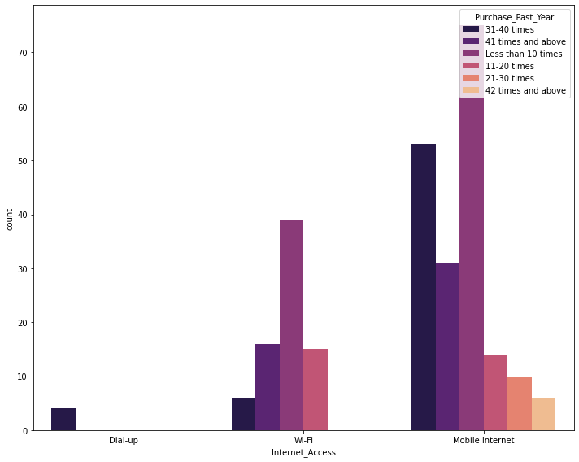

Slide 32
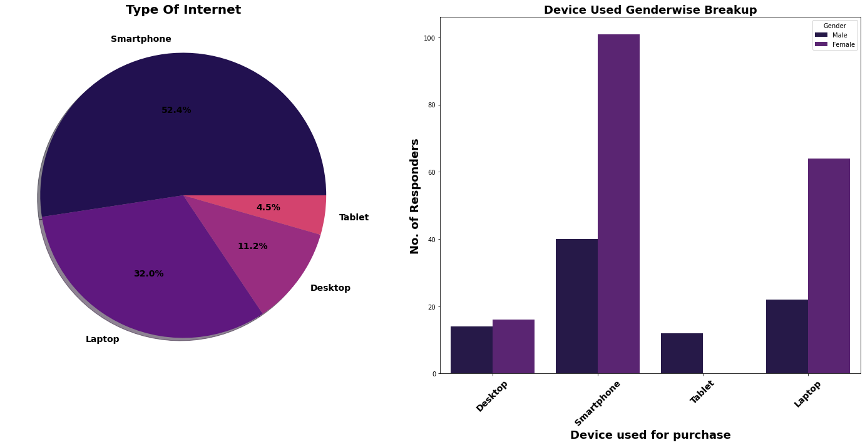

Slide 33
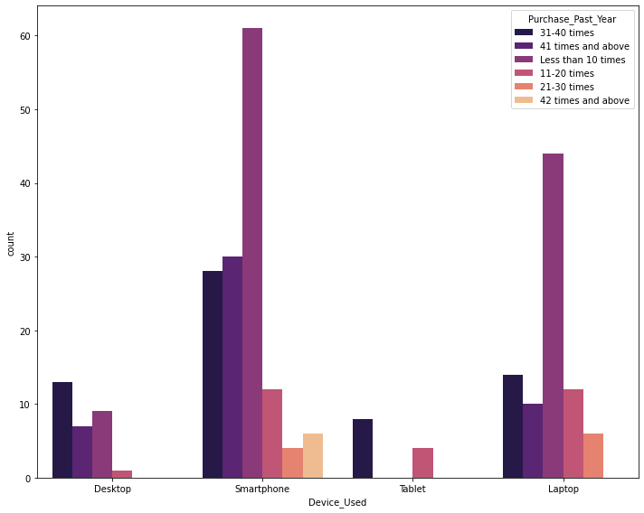

Slide 34
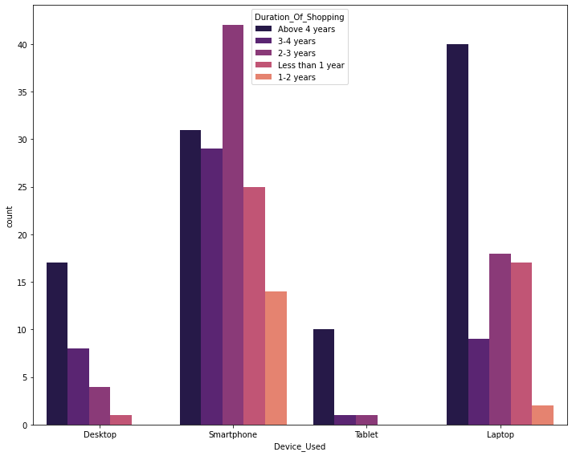

Slide 35
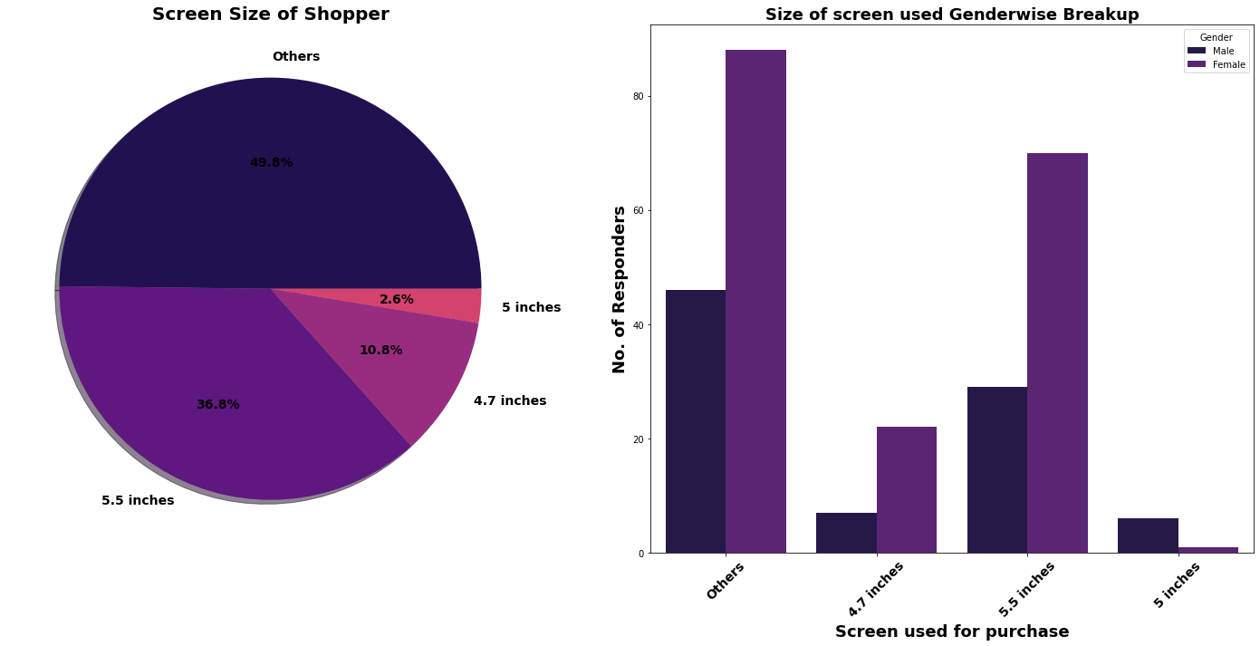

Slide 36
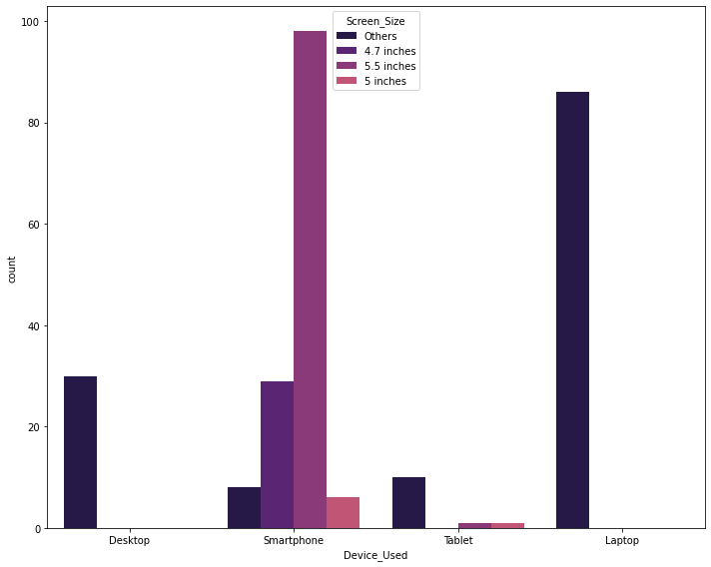

Slide 37
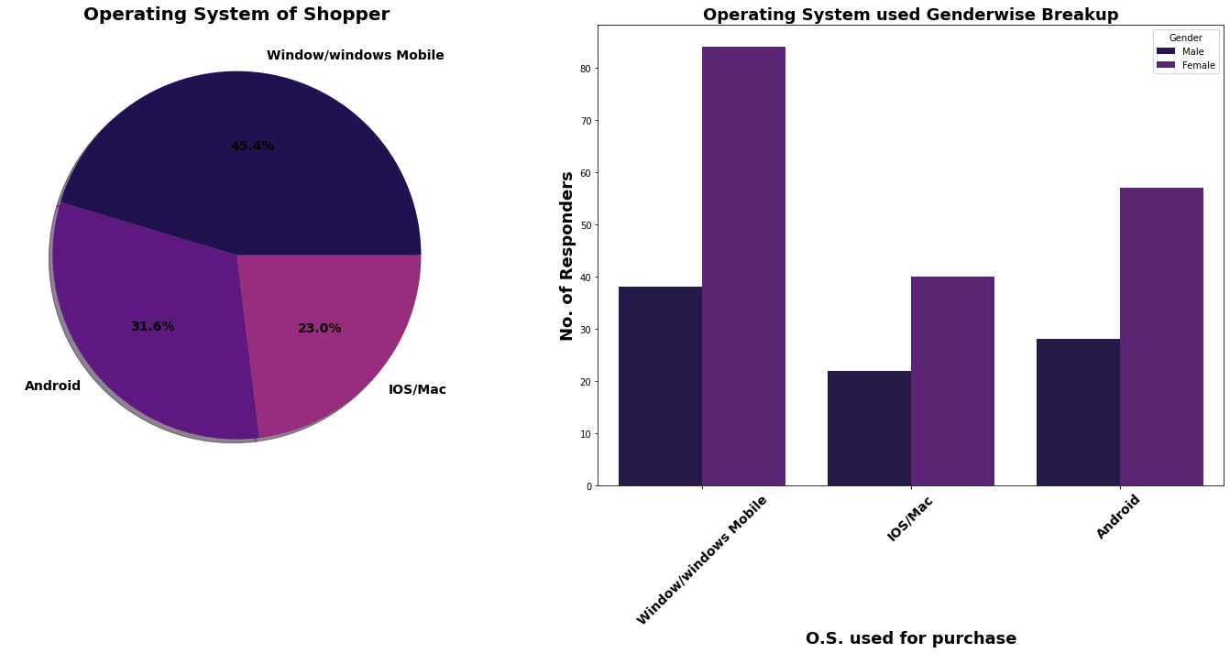

Slide 38
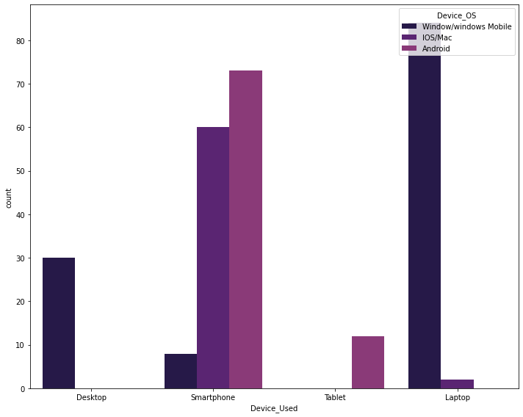

Slide 39
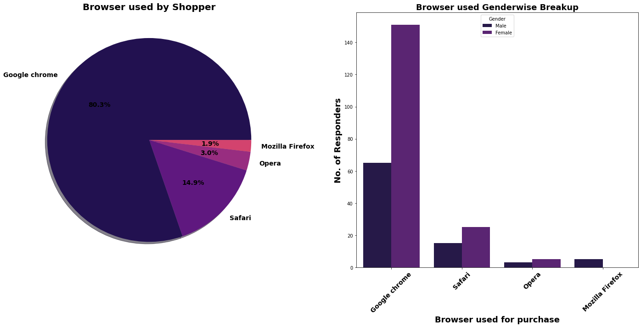

Slide 40
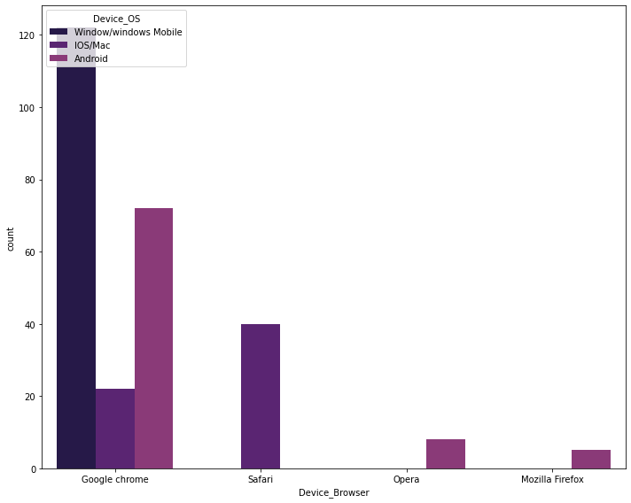

Slide 41
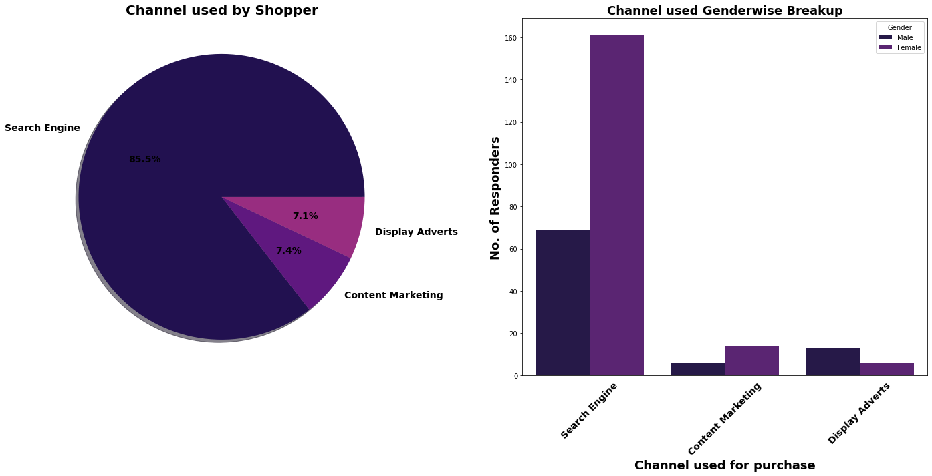

Slide 42
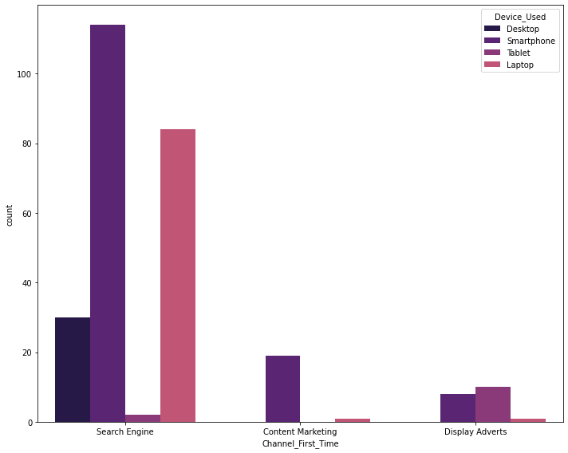

Slide 43
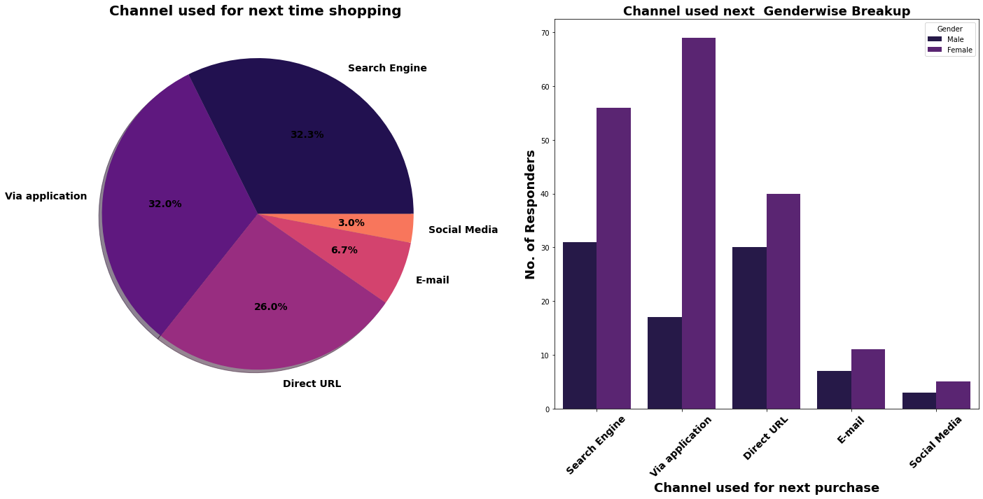

Slide 44
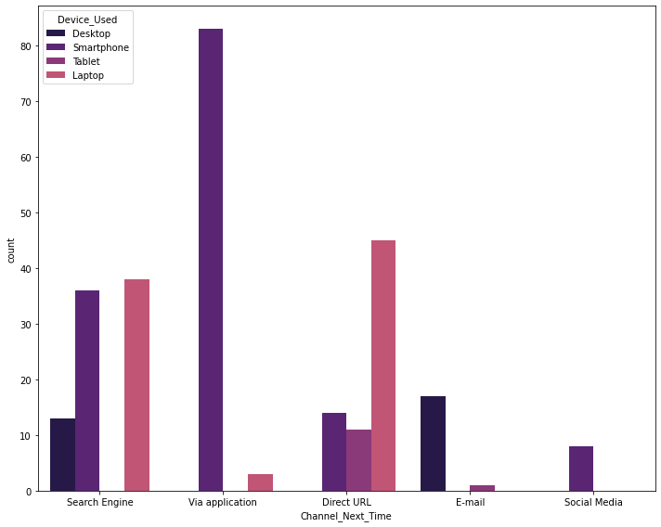

Slide 45
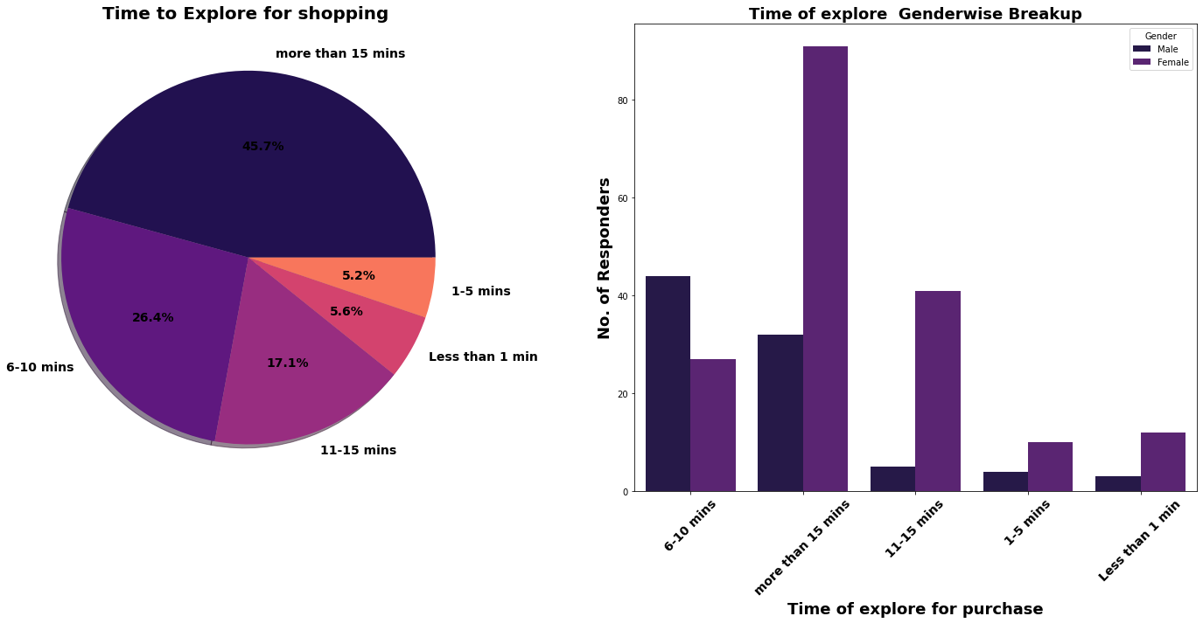

Slide 46
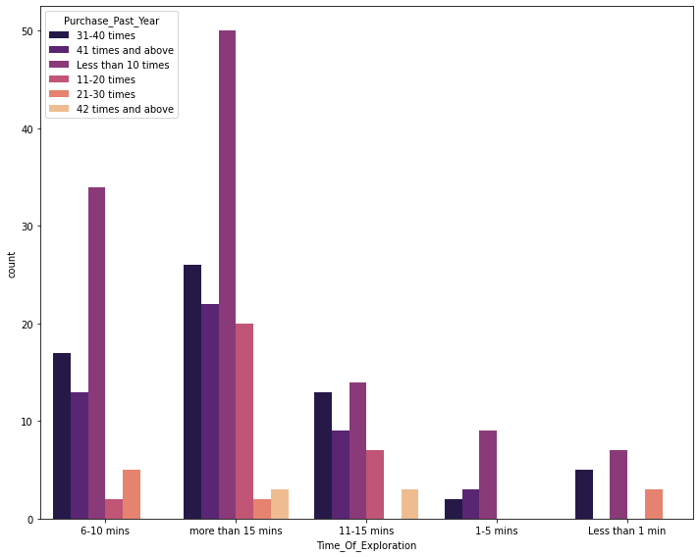

Slide 47
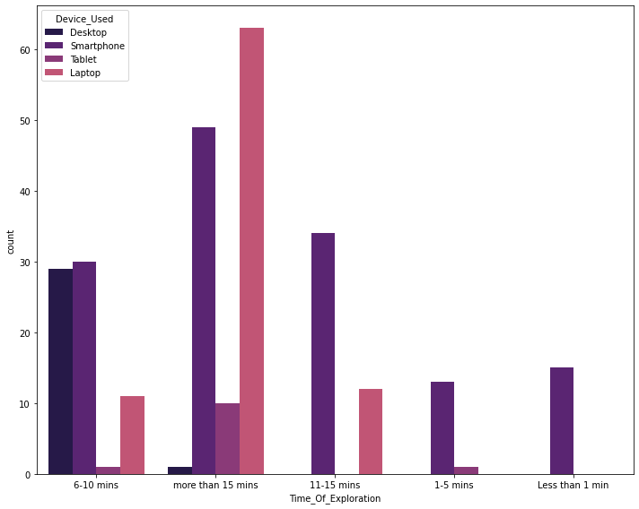

Slide 48
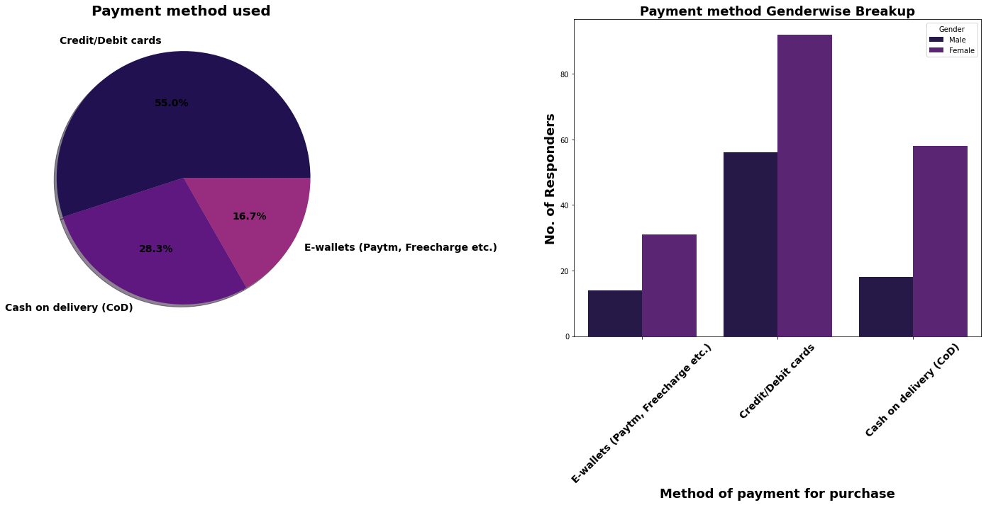

Slide 49
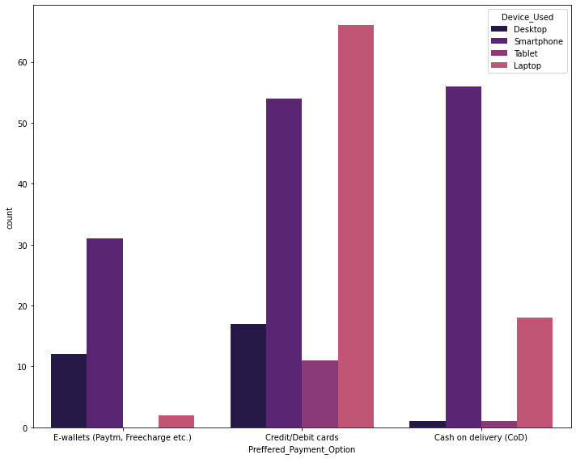

Slide 50
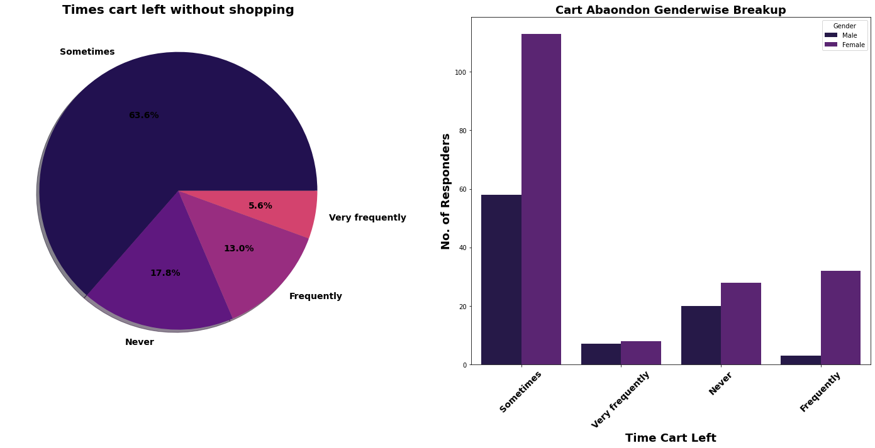

Slide 51
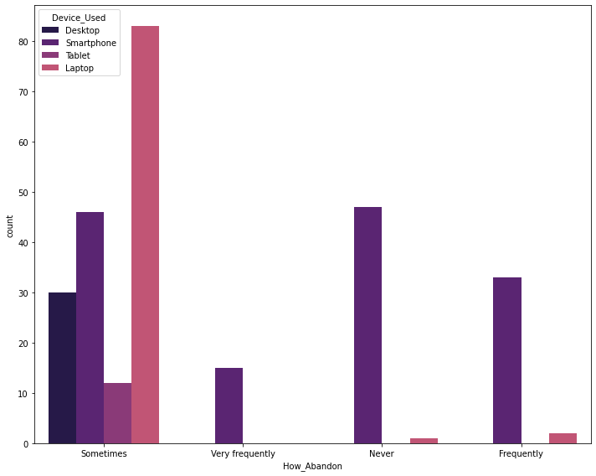

Slide 52
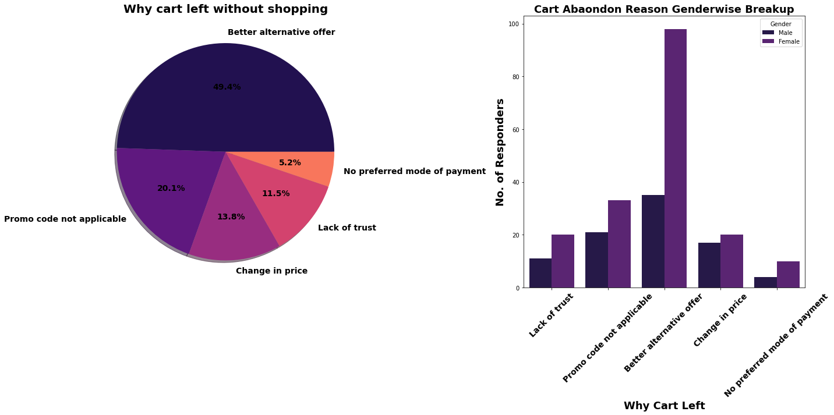

Slide 53
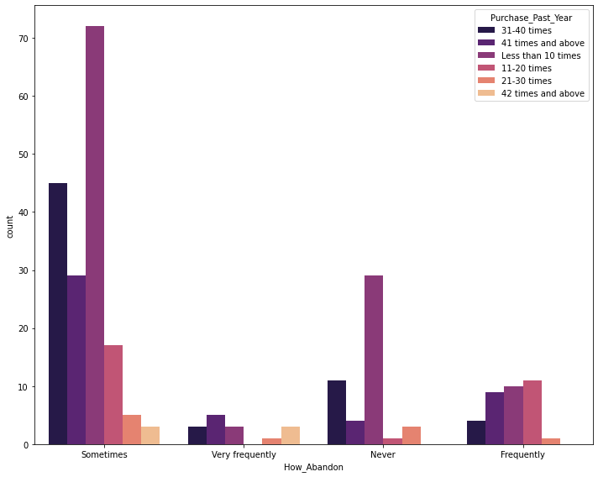

Slide 54
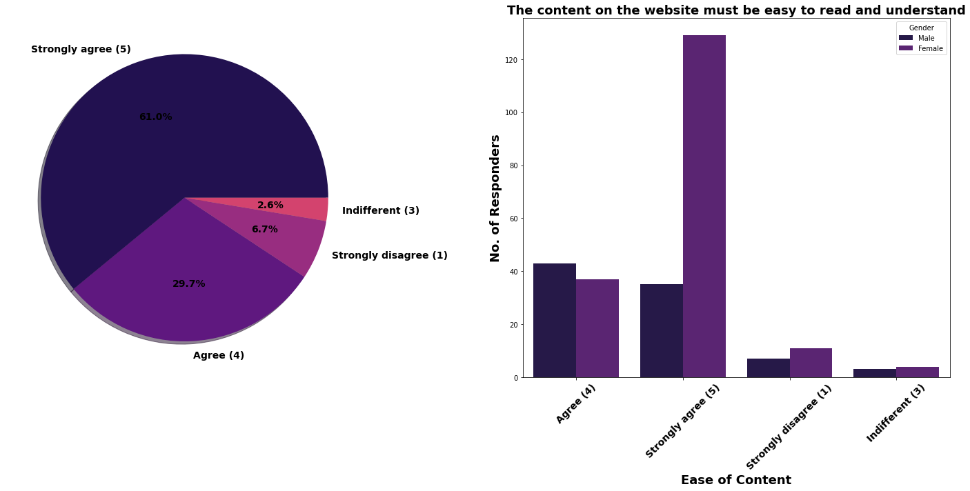

Slide 55
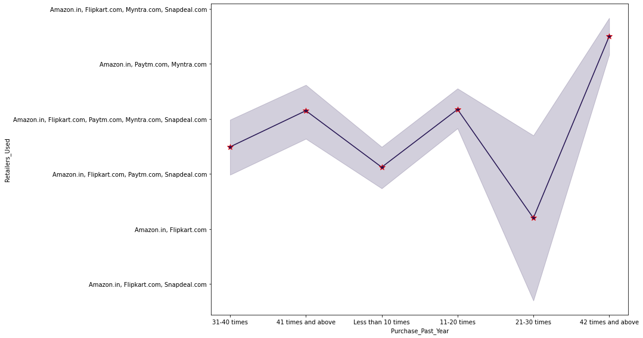

Slide 56
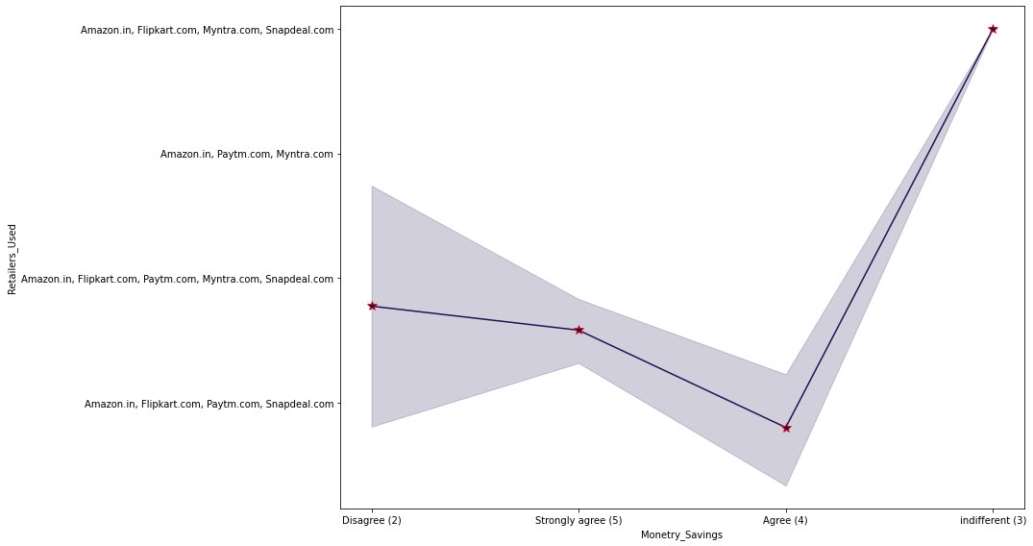

Slide 57
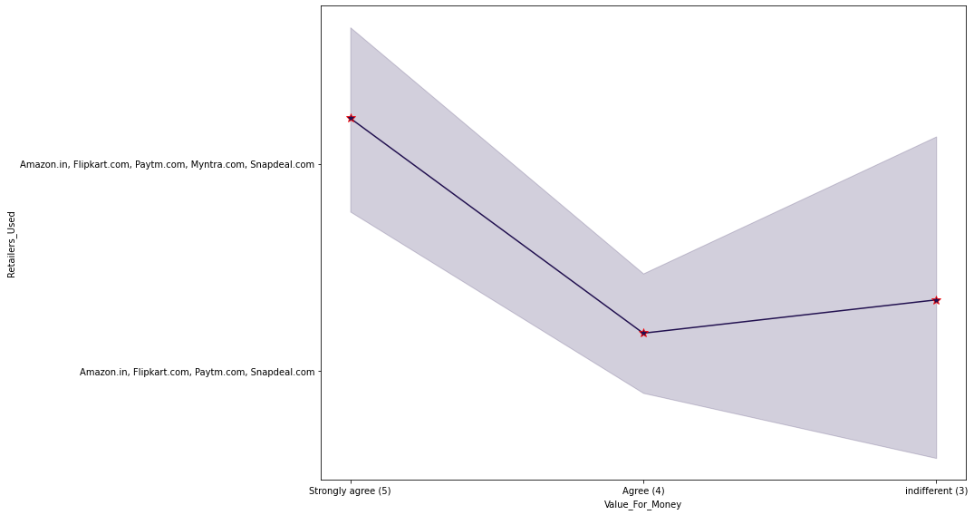

Slide 58


Slide 59
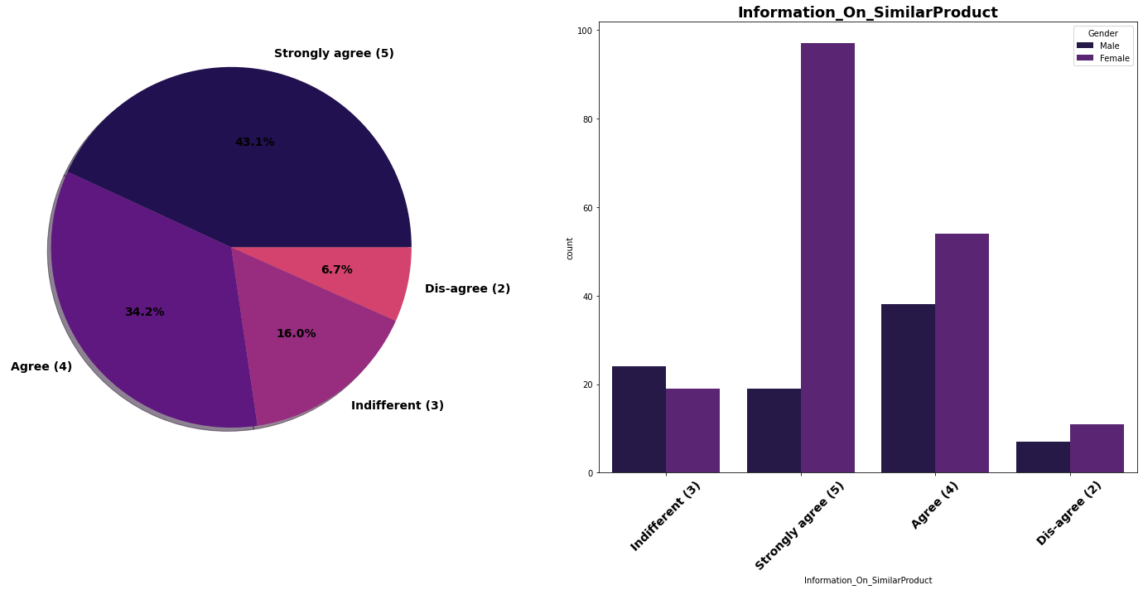

Slide 60
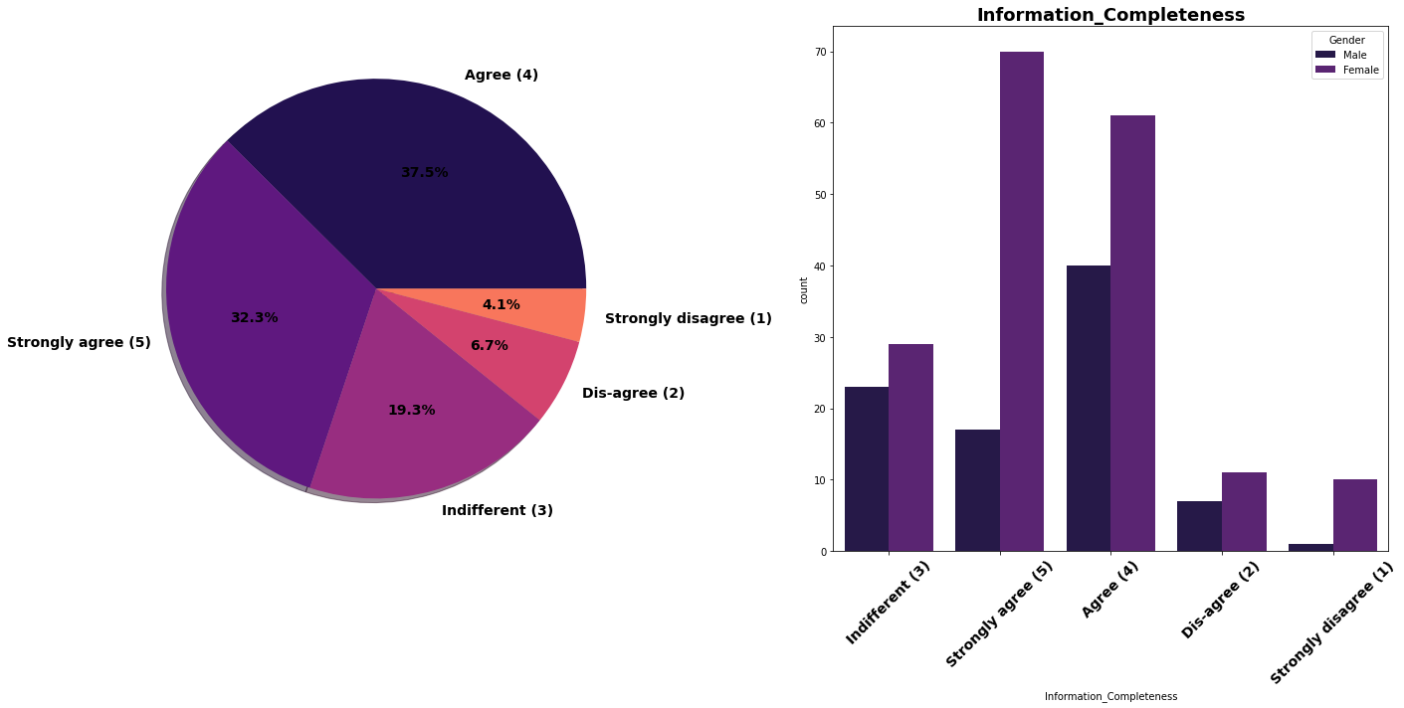

Slide 61
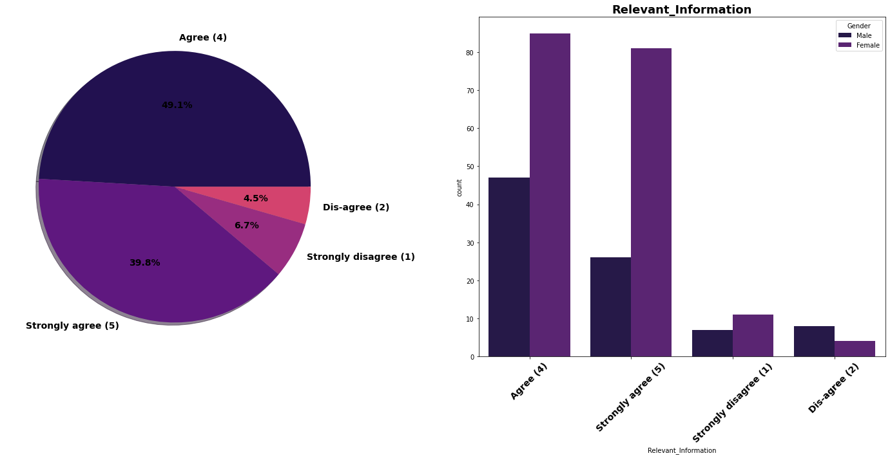

Slide 62
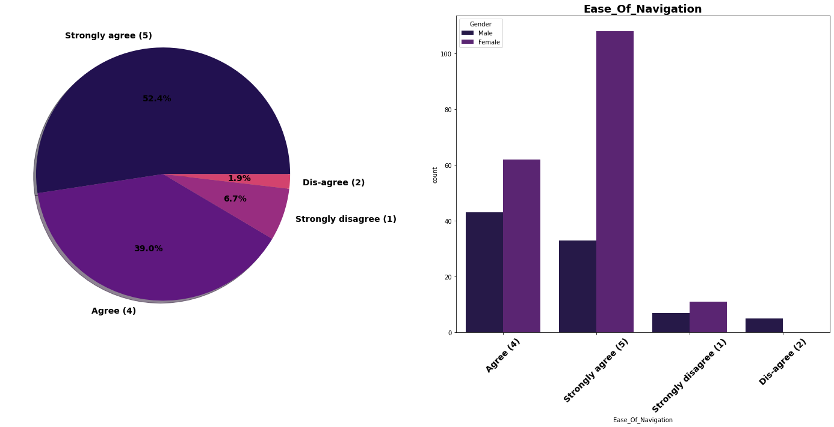

Slide 63
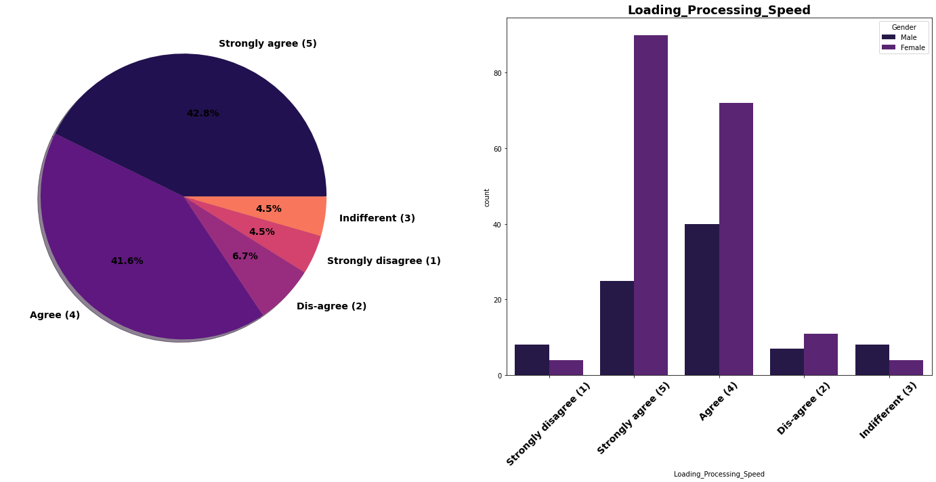

Slide 64
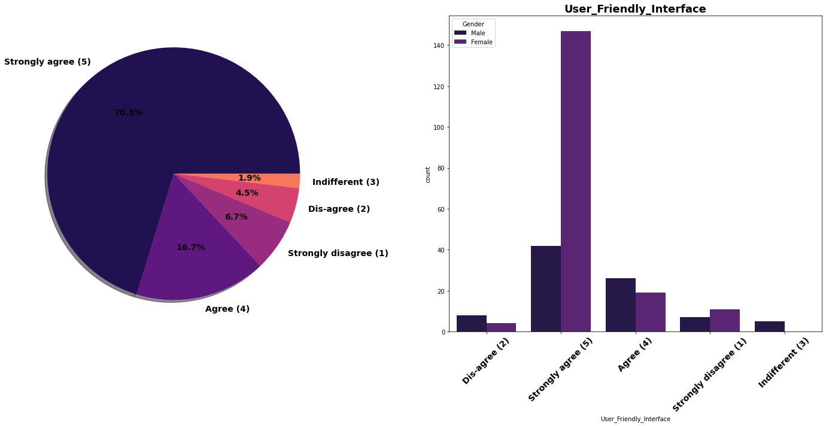

Slide 65
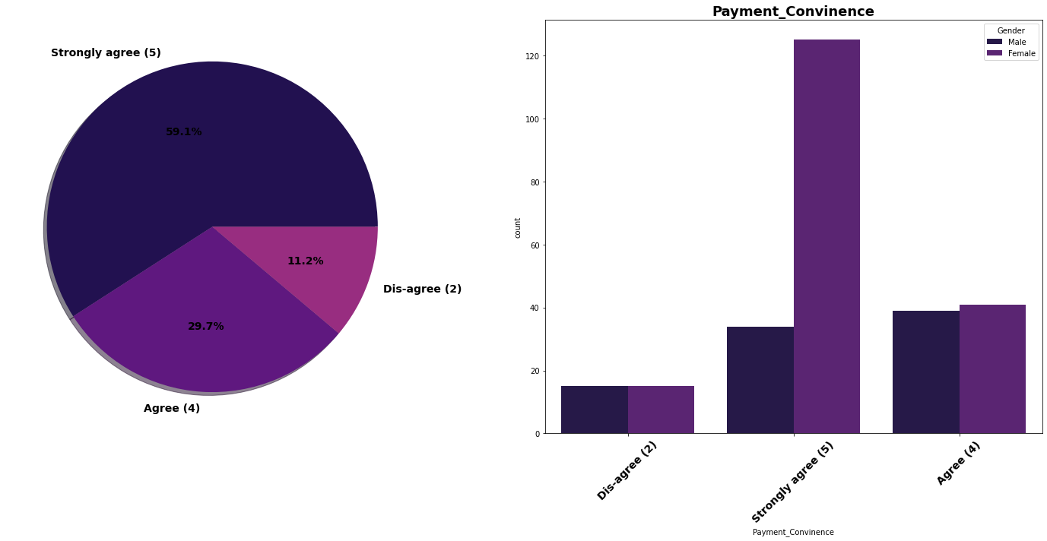

Slide 66
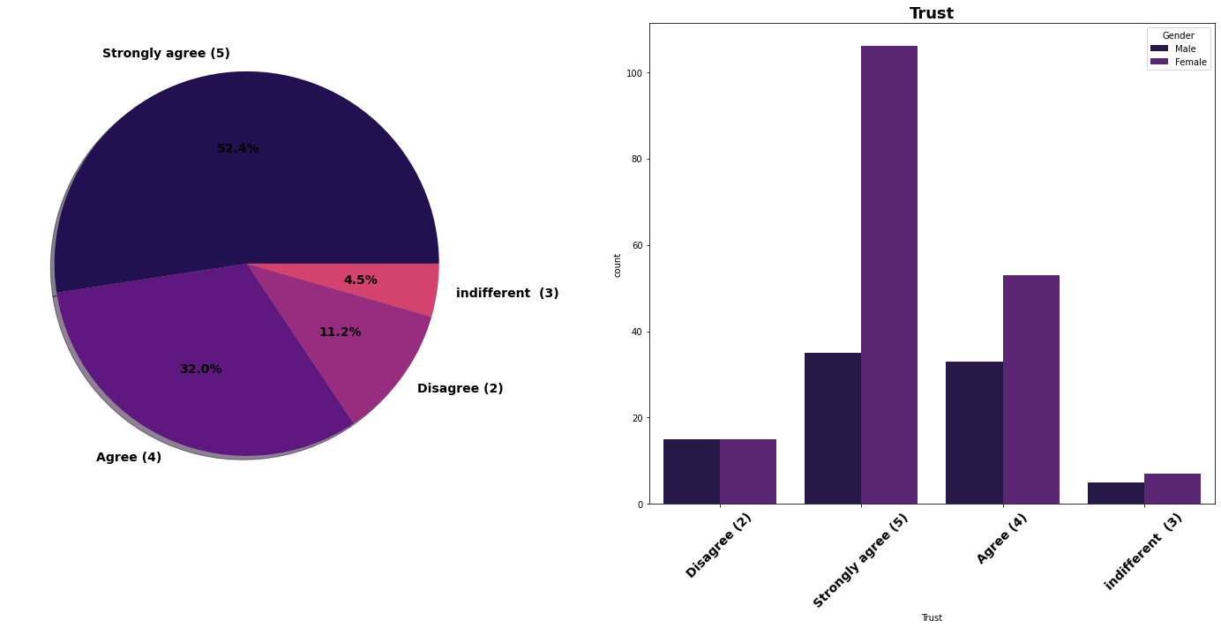

Slide 67
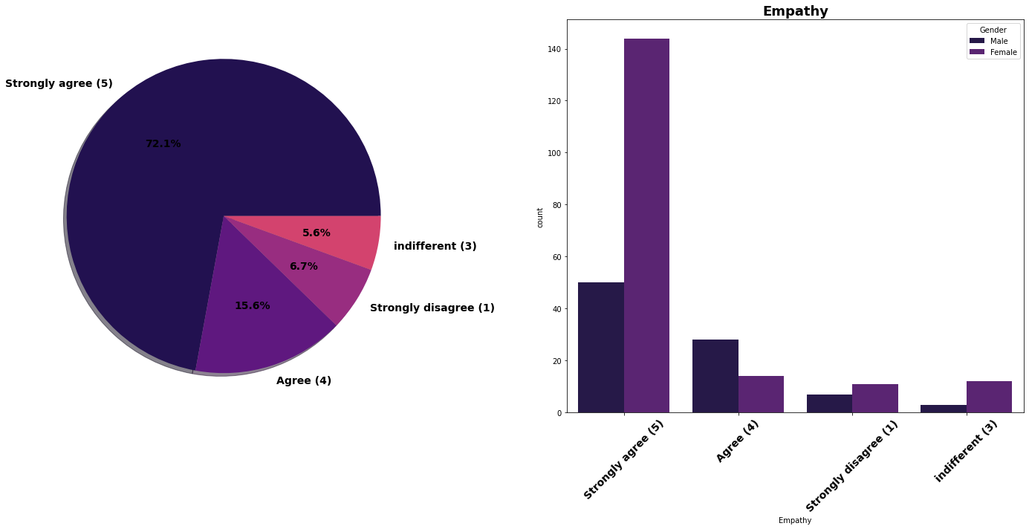

Slide 68
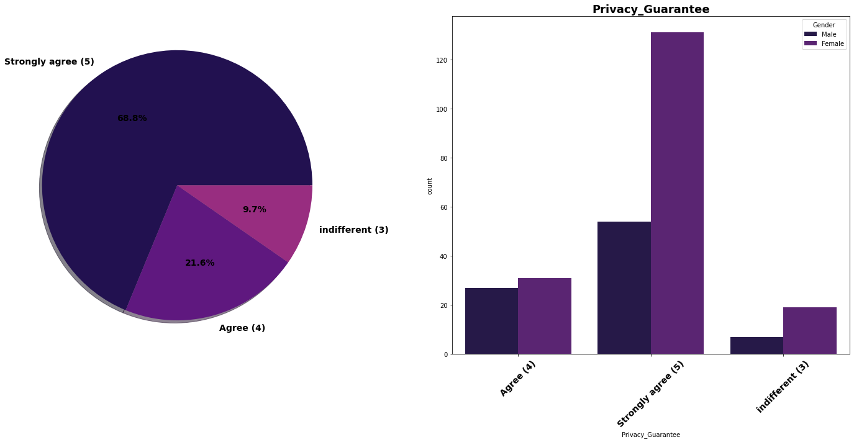

Slide 69
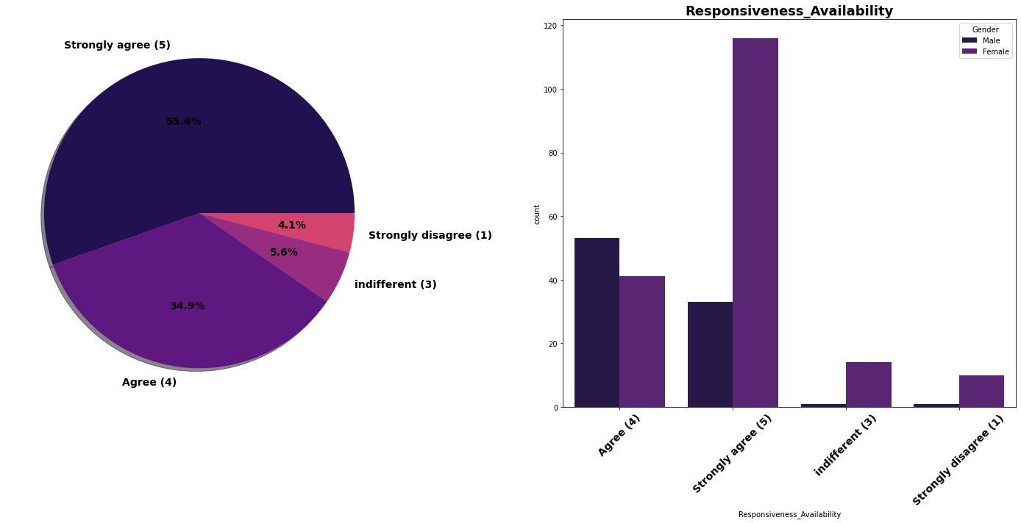

Slide 70
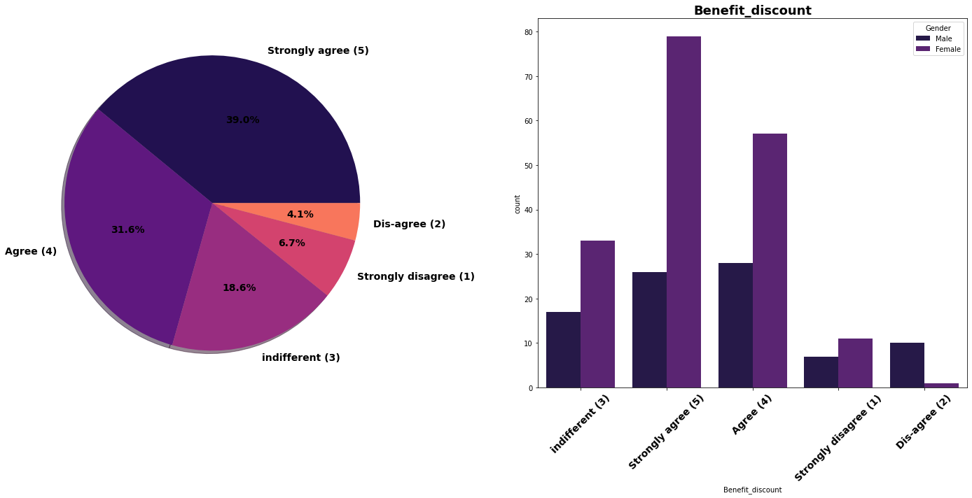

Slide 71
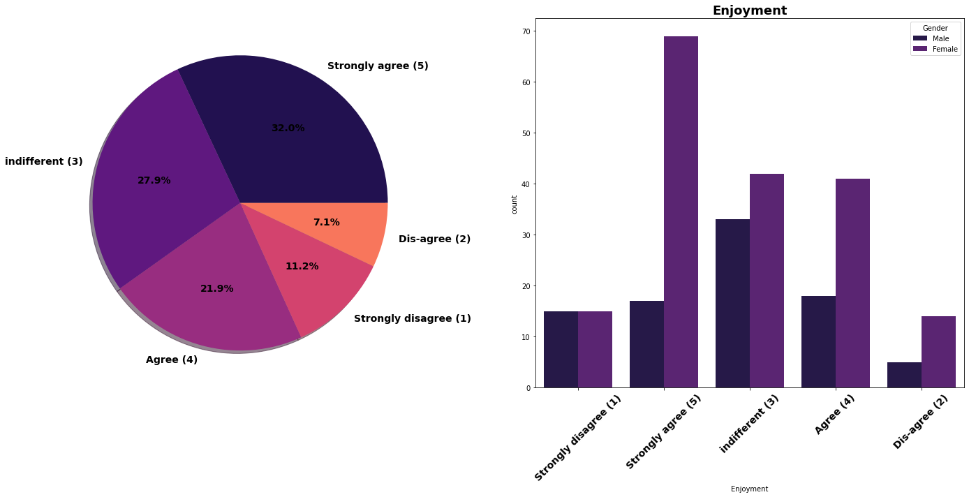

Slide 72
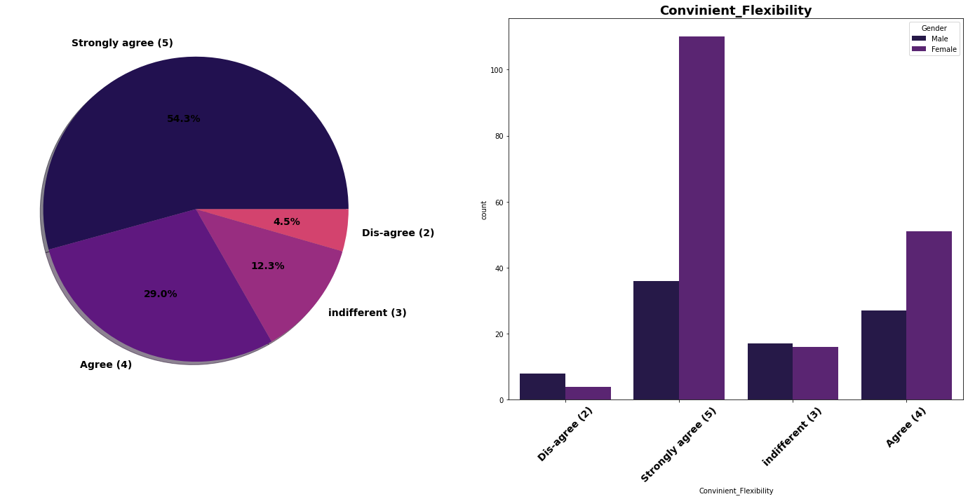

Slide 73
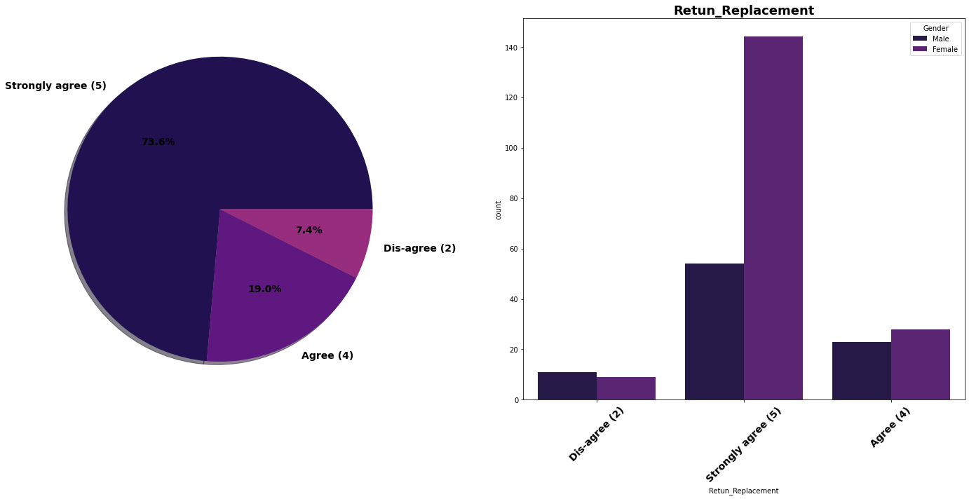

Slide 74


Slide 75


Slide 76


Slide 77


Slide 78


Slide 79


Slide 80


Slide 81


Slide 82


Slide 83


Slide 84


Slide 85


Slide 86


Slide 87


Slide 88


Slide 89


Slide 90


Slide 91


Slide 92


Slide 94


Slide 95


Slide 96


Slide 97


Slide 98


Slide 99


Slide 100


Slide 101


Slide 102


Slide 104


Slide 105


Slide 106


Slide 107


Slide 108


Slide 109


Slide 110


Slide 111


Slide 112


Slide 113


Slide 114


Slide 115


Slide 116


Slide 117


Slide 118


Slide 119


Slide 120


Slide 121


Slide 122


Slide 123


Slide 124


Slide 125


Slide 126


Slide 127


Slide 128


Slide 129


Slide 130


Slide 131


Slide 132


Slide 134


Slide 135


Slide 136


Slide 137


Slide 138


Slide 139


Slide 140


Slide 141


Slide 142


Slide 143


Slide 144


Slide 145


Slide 146


Slide 147


Slide 148
Conclusions
The number of women is double than men who have taken this survey.
Most of the people are in their 30's followed by 20's, teenagers and senior citizen are the least in number.
Most of the people belong from delhi, noida and banglore.
Most of the people shopping online have been shopping from a long time.
Majority of people shop online 10 times a year.
Heavy shoppers who shop more than 41 times a year shop from all the online brands, some of the people who shop for 32-40 and Less than 10 times a year seem to exclude myntra. People shop from Amazon and flipkart mostly.

Slide 149
Conclusions
Highest number of people have been shopping online for above 4 years except for the age group below 20 years and above 50 years.
People who are shopping online for 1-2 years does not include teenagers and elder people.
Even though people who are shopping online for more than 3 years don’t use the application rather use search engine and direct url's in large number which indicates that online brands should update all their platforms rather than just application.
Amazon, Flipkart have maintained a very good brand image followed by paytm and the myntra.
Most of the time people abandon the bag is beacuse they get a better alternative offer or promo code not applicable.
Lack of trust seen in amazon, flipkart and paytm by some people.

Slide 150
Thank You

